Slide 1

Pennsylvania Household Income vs Restaurant Ratings
Group 3: Nisha, Charlie, Akshada, Kyle, and Jared

Slide 2

Agenda
Planning and Background
Analysis
Conclusion

Slide 3

Planning

Slide 4


Business Question
Exploring the relationship between average median household income by cities in Pennsylvania and average Yelp ratings.
Stockholder insights:
Customer Preferences
Expansion Opportunities

Slide 5

Hypothesis
Median Household Income vs. Yelp Rating
Positive Correlation
More disposable income
Different economic classes will have different priorities

Slide 6
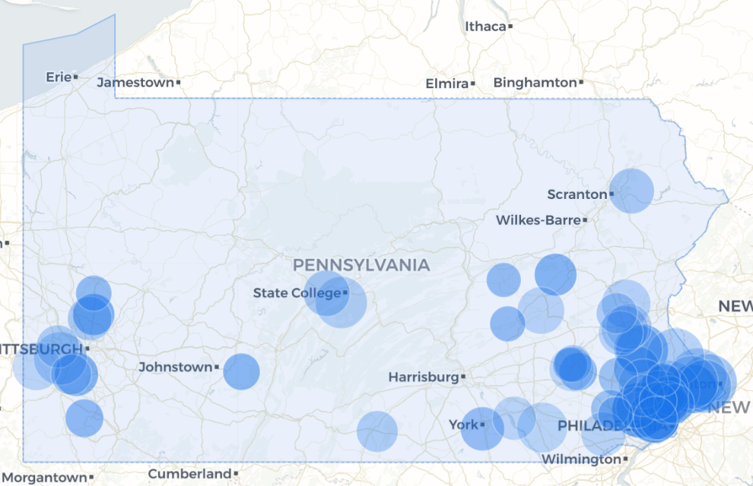
Data Collection
Median Household Income
Used Zipatlas.com to locate Pennsylvania income data
Filtered by city to find each cities median household income
Imported data into excel file with each city median household income data
https://zipatlas.com/us/pa/city-comparison/highest-median-household-income.html

Slide 7

Yelp Data
Business Table
Category Table
Review Table
User Table
Income Table
Business ID
Name
Address
City
State
Postal Code
Latitude
Longitude
Stars
Review Count
Is Open
Business ID
Category Name
Review ID
Business ID
User ID
Stars
Date
Useful Votes
Funny Votes
Cool Votes
User ID
Name
Review Count
Yelping Since
Average Stars
Various types of votes
City
Income

Slide 8

Analysis

Slide 9


Challenges
Finding
Finding a reliable data set for median household income on a city-to-city basis in Pennsylvania.
Transforming
Transforming the data we found into useable information

Slide 10
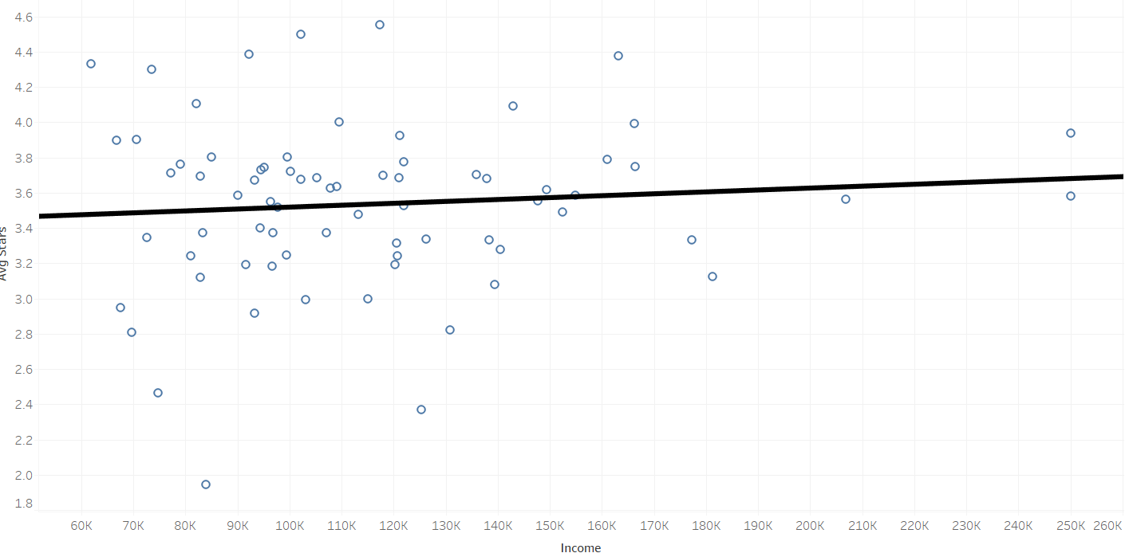
Scatter Plot Analysis

Slide 11


Looking at the Numbers
P-value: 0.459371
R squared: 0.0077346
Avg Stars = 1.08028e-06*Income + 3.41019

Slide 12
Looking at the Numbers
Takeaways
No strong correlation between variables
+10K more income = +0.1 average stars
Implies 3.4 is standard with 0 income
Further Breakdown
Look at High vs Low Ends
Anywhere where the relationship is stronger

Slide 13
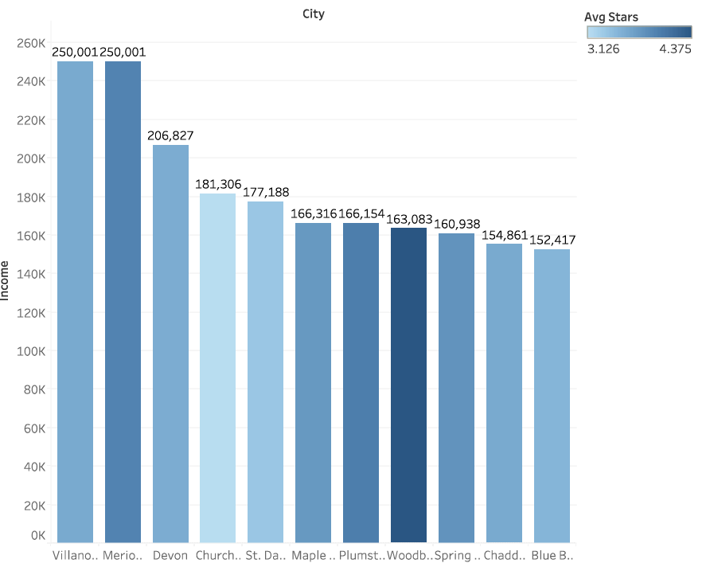
Highest Income Cities
Cities with Income > $150,000
Average Rating:
3.684 Stars

Slide 14
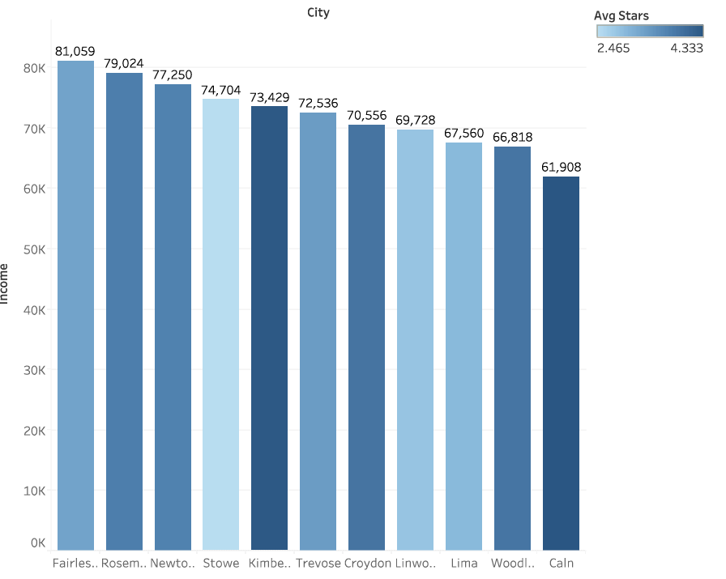
Lowest Income Cities
Cities with Income < $82,000
Average Rating:
3.520 Stars

Slide 15
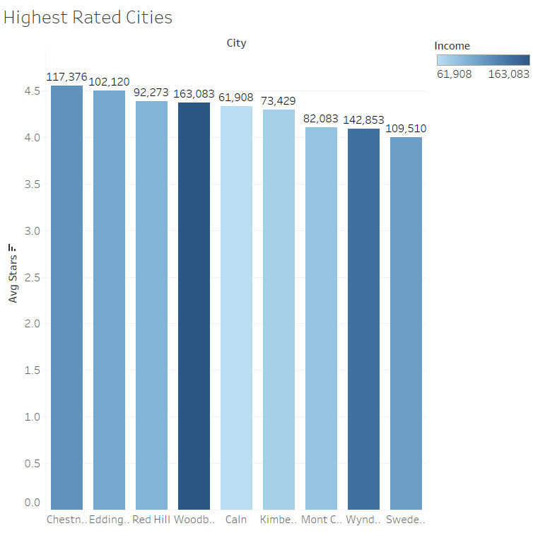
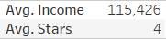
Cumulative Averages
The cumulative average rating is higher than the average rating in both the highest and lowest income cities.
The cities with the highest average ratings fall between these two groups.

Slide 16

Conclusion and Next Steps
Too weak of correlation to be material
Business expansion complications
Other factors not included
Tourism
Restaurant types
Integrity of reviews
Next Steps:
Strengthen restaurant categories
Factor in cost of living
Different Data Collection
Onsite vs. online reviews

Slide 17
Questions?

